Slide 2
Introduction to Git and GitHub

Slide 3
Introduction to Git and GitHub
Mohit Bishesh Alpha MLSA
(3*azure certified)

Slide 4
What will we Cover?
Version control system.
Git
Git commands.
Hands on Git.
GitHub
Hands on GitHub.
Doubts and queries
Quiz

Slide 5
Answers you will have at end
What is Git?
How Git works?
Need of Git For developers?
Basic Git commands.
Are Git and GitHub same?

Slide 6
Prerequisites:
Installation of Git
Installation of VS Code
A GitHub account

Slide 7
What is version control system
Track modifications
Revert files or projects back to previous versions
Concurrent modifications
Easy rollback to previous version
Easy to manage the codes and files

Slide 8
Types of Version control System
Centralized VCS
Distributed VCS

Slide 9
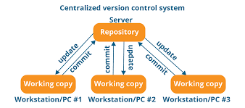
Centralized version control system
Image Source

Slide 10
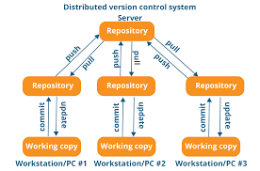
Distributed version control system
Image Source

Slide 11

What is Git
Image Source

Slide 12
Why Git?
Efficient and Fast
Distributed Architecture
Collaboration and Teamwork
Branching and Merging

Slide 13
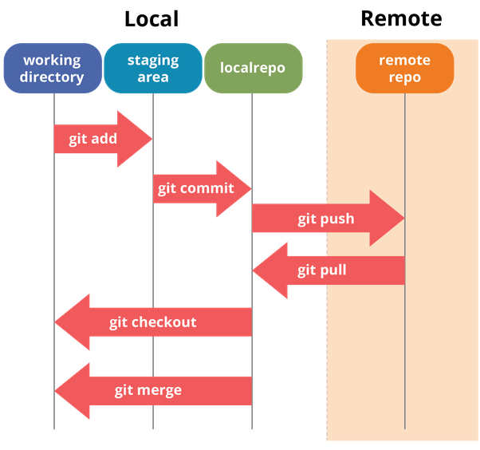
Git commands and stages
Image source

Slide 14
Git Demonstration

Slide 15

What is GitHub
Image Source

Slide 16
Advantages of GitHub
Git Repository Hosting
Collaboration and Social Coding
Issue Tracking
Code Review
Continuous Integration and Deployment
Community and Open-source Projects
Documentation

Slide 17
GitHub Demonstration

Slide 18
Doubts and Queries

Slide 19

Image Source

Slide 20

Image source

